Slide 1

Impact of major Felony offenses on number of Houses Sold in NYC
Presented by:
Charu Girdhar
Team Members:
Charu Girdhar
Navya Mayasandra Vardhamanaiah
Sameera Magoo
Sneha Naik

Slide 2

Project Background
Place:
New York
City
Needs: Crime Data relation to number of houses sold
Motivation: To determine if there is a relation between the real estate and the criminal offenses

Slide 3
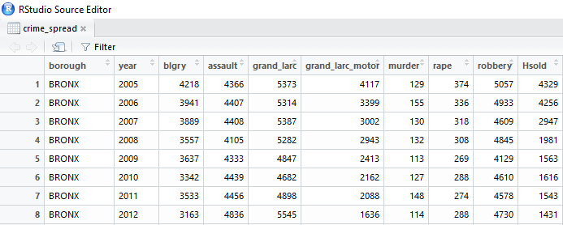
Overview of Data
10 variables
7 Factors
1 Response
60 observations
Data Set Used: From NYC website detailing crime details across years, 2005-2016

Slide 4
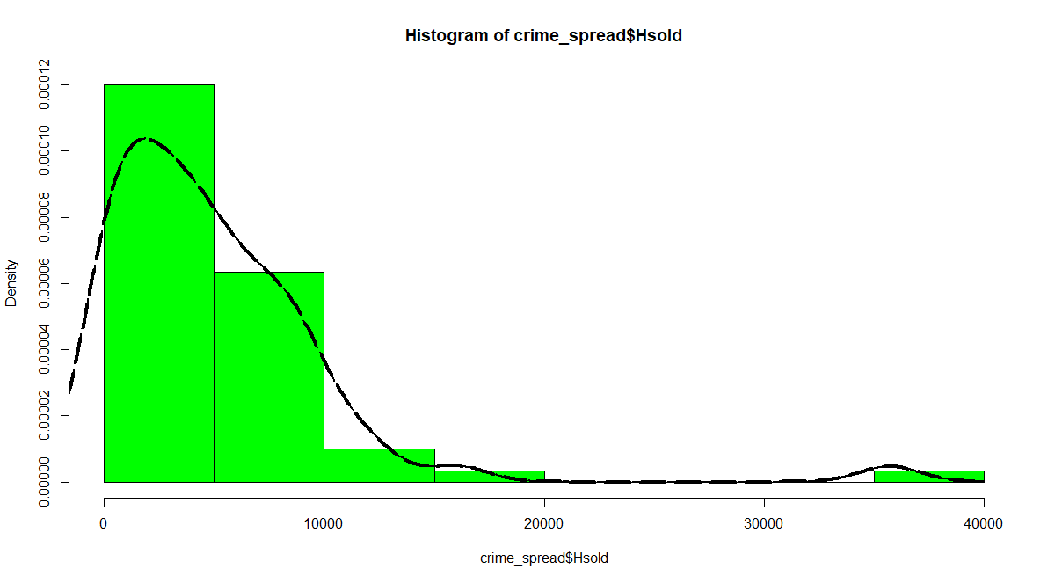
Methodology
GLM model with family as Poisson distribution is a good fit since our dependent variable is categorized as a count (number of households sold in borough in NYC) and not a continuous variable
Histogram for Houses sold variable follows Poisson distribution

Slide 5


Models
The 2 models selected for analysis are:
Without “Robbery”
Model 1 = glm( Hsold ~ rape + grand_larc_motor ,crime_spread, family = poisson)
With “Robbery”
Model 2 = glm( Hsold ~ rape + grand_larc_motor + robbery ,crime_spread, family = “poisson”)
AIC: 119551
BIC: 119556.9
AIC: 86130
BIC: 86138.88

Slide 6
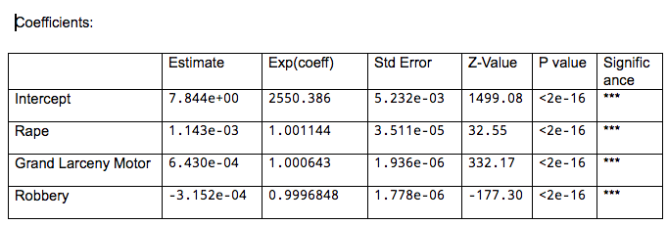
Results/Analysis
All the coefficients look highly significant in the model
Estimate - Log of odds
Exp(Coeff) – Actual coefficient
Residual Deviance < Null Deviance
Our model fits better than the null model with no predictors.
Null deviance | 268081 | 59
Residual Deviance | 85540 | 56

Slide 7
THANK YOU !

